Slide 1

The Autohive
Smart parking system with Arduino
Maria Vardanyan
13.12.2023

Slide 2

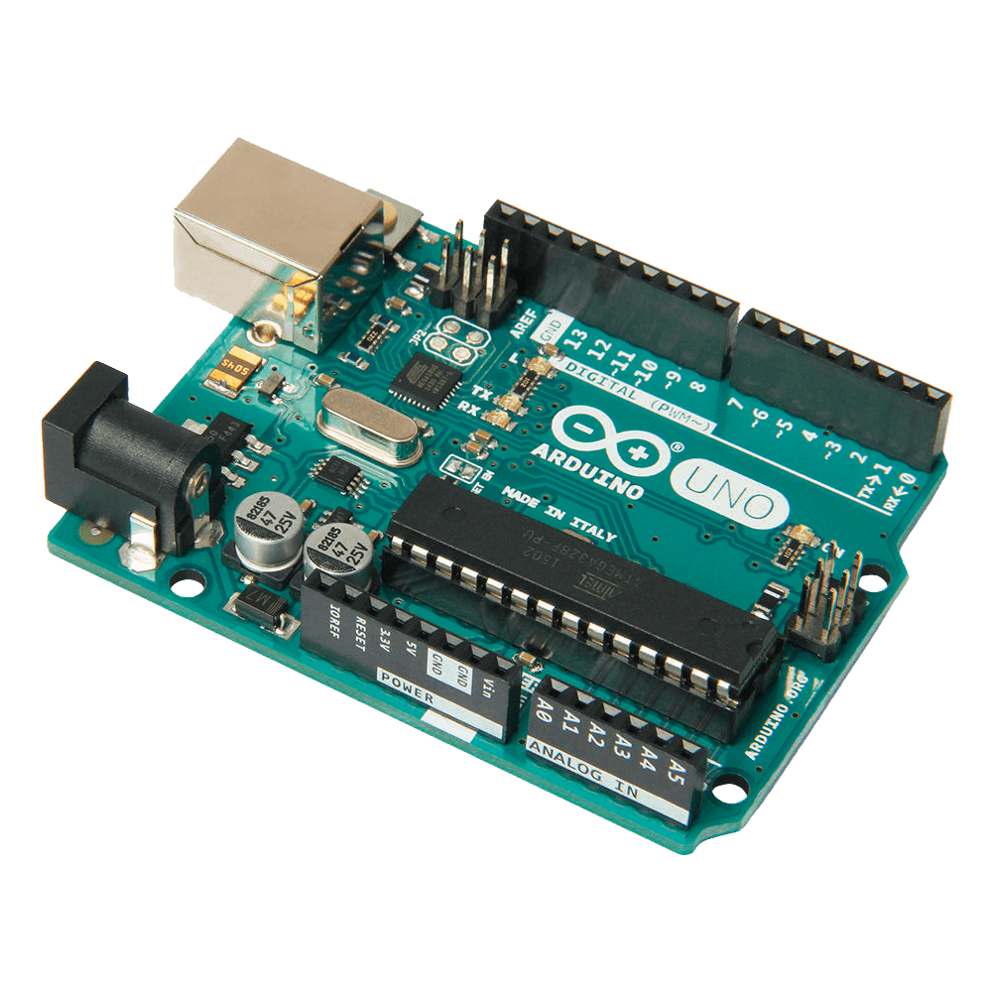

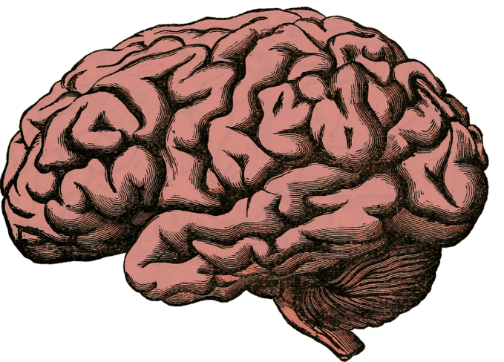
Revolutionizing Parking Space Management with Arduino
+
+
=
Developing a mini smart parking system to optimize parking space utilization and provide real-time information to drivers.

Slide 3

Revolutionizing Parking Space Management with Arduino
+
+
=
Developing a mini smart parking system to optimize parking space utilization and provide real-time information to drivers.

Slide 4
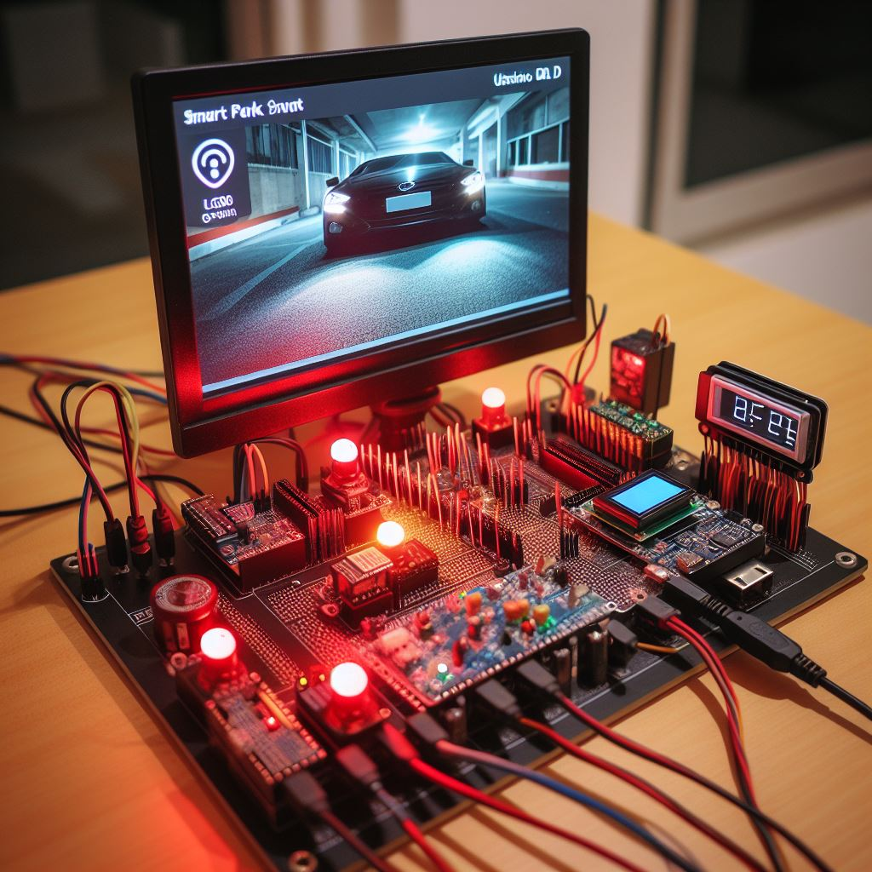
Key components of “The Autohive”
Arduino Uno R3
Servo motor for barrier control
Ultrasonic sensors for distance measurement
LEDs for status indication
LCD for real-time information display

Slide 5
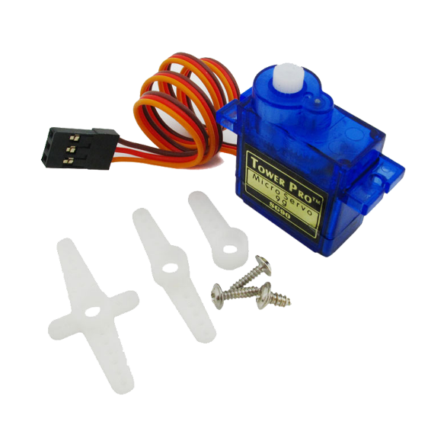
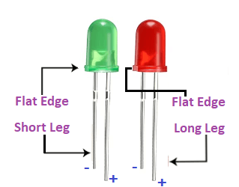
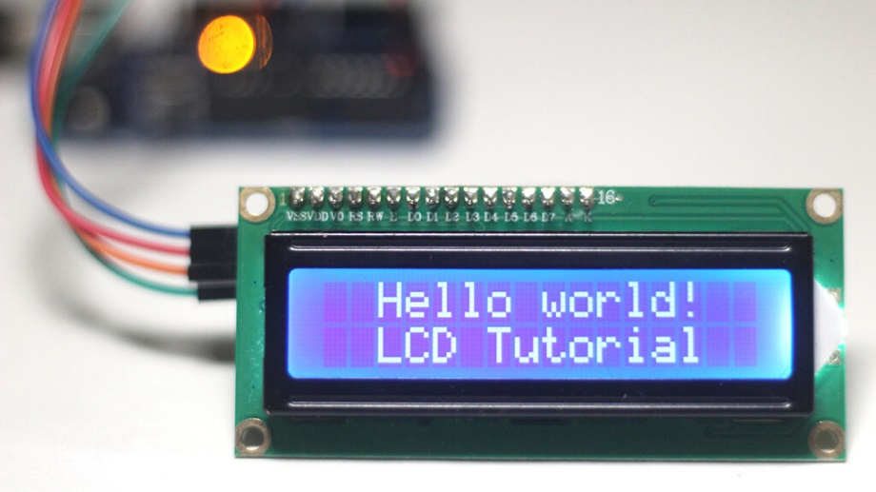
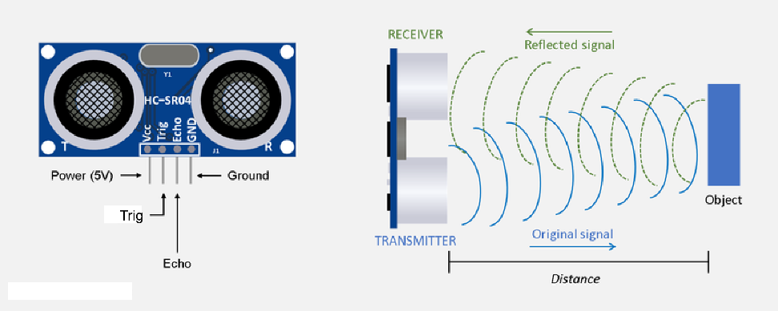
Key components of “The Autohive”
Arduino Uno R3
Servo motor for barrier control
Ultrasonic sensors for distance measurement
LEDs for status indication
LCD for real-time information display

Slide 6
The image of The Autohive system
Arduino
Servo Motor
Power
LCD Display
Ultrasonic IN
Ultrasonic OUT
Buzzer Dynamic

Slide 7
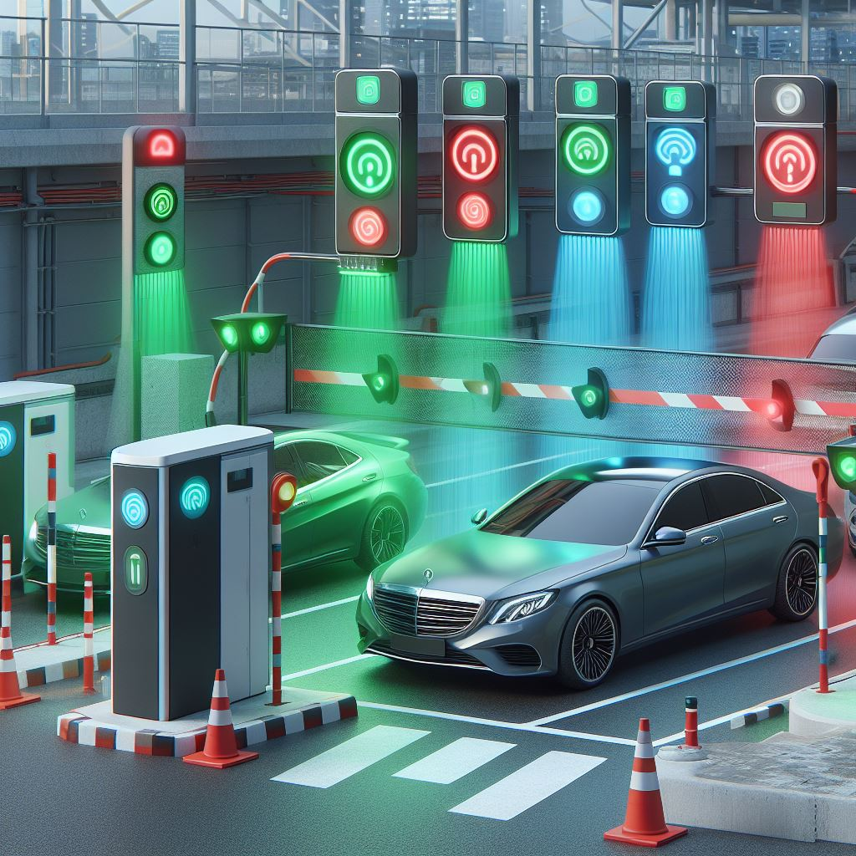
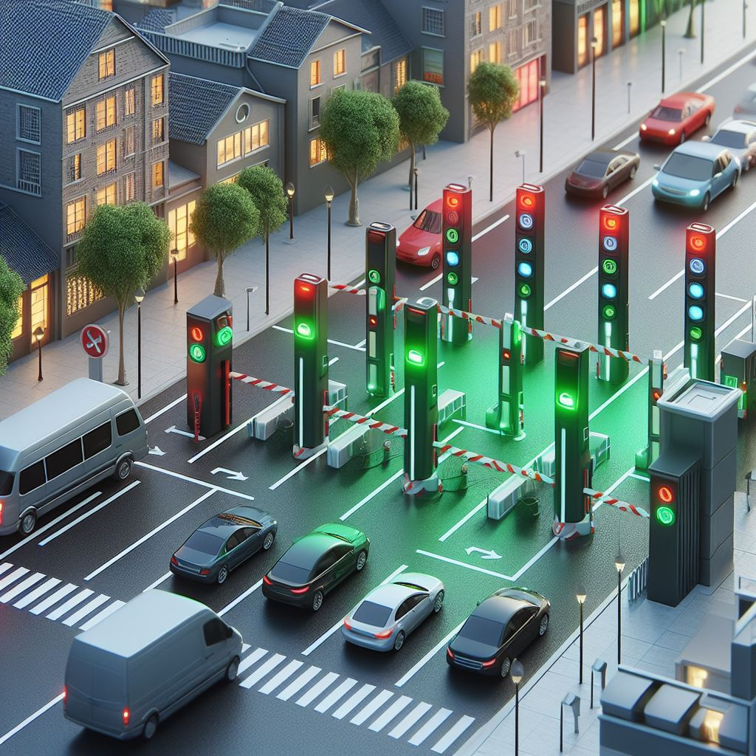
Thank you for your time!

